Slide 1
Structured Chart

Slide 2
Introduction
Structure Chart represent hierarchical structure of modules. It breaks down the entire system into lowest functional modules, describe functions and sub-functions of each module of a system to a greater detail. Structure Chart partitions the system into black boxes (functionality of the system is known to the users but inner details are unknown). Inputs are given to the black boxes and appropriate outputs are generated.
Modules at top level called modules at low level. Components are read from top to bottom and left to right. When a module calls another, it views the called module as black box, passing required parameters and receiving results.

Slide 3
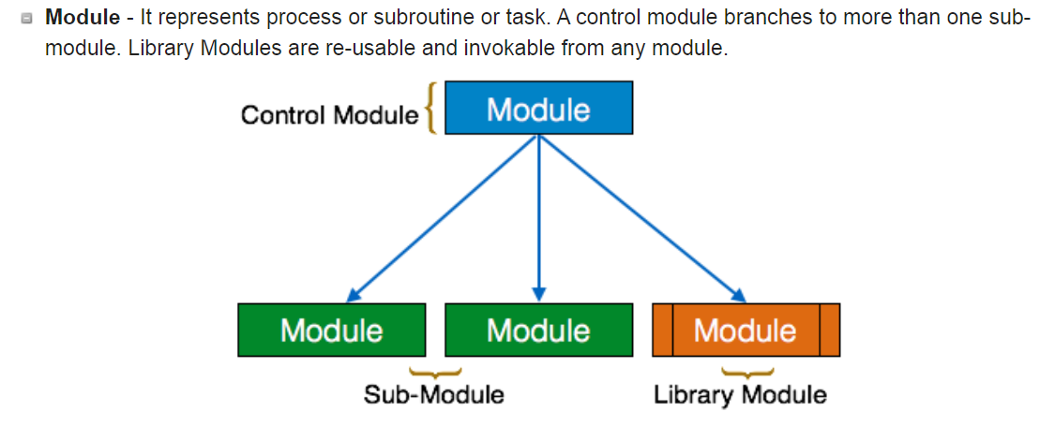
symbols used in construction of structure charts

Slide 4
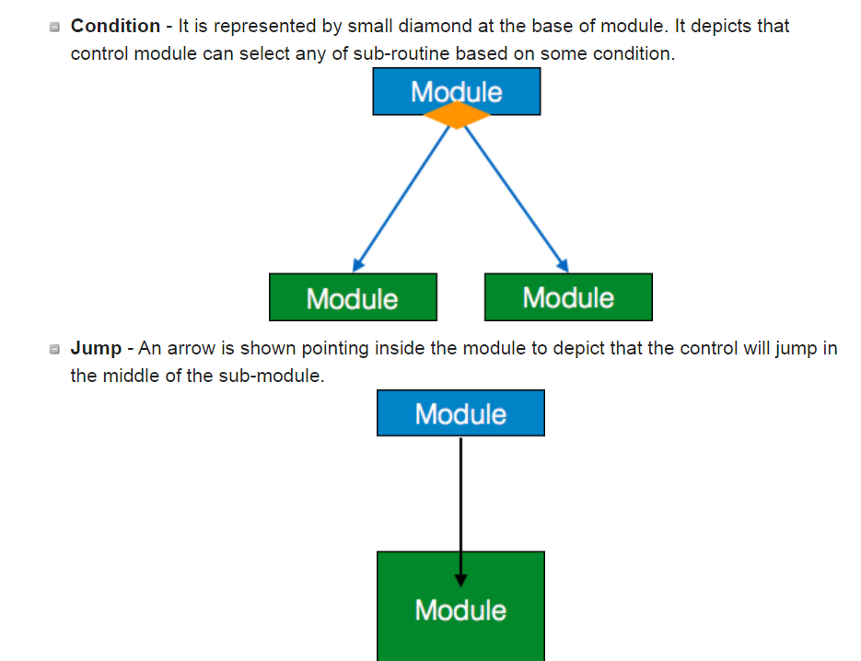

Slide 5
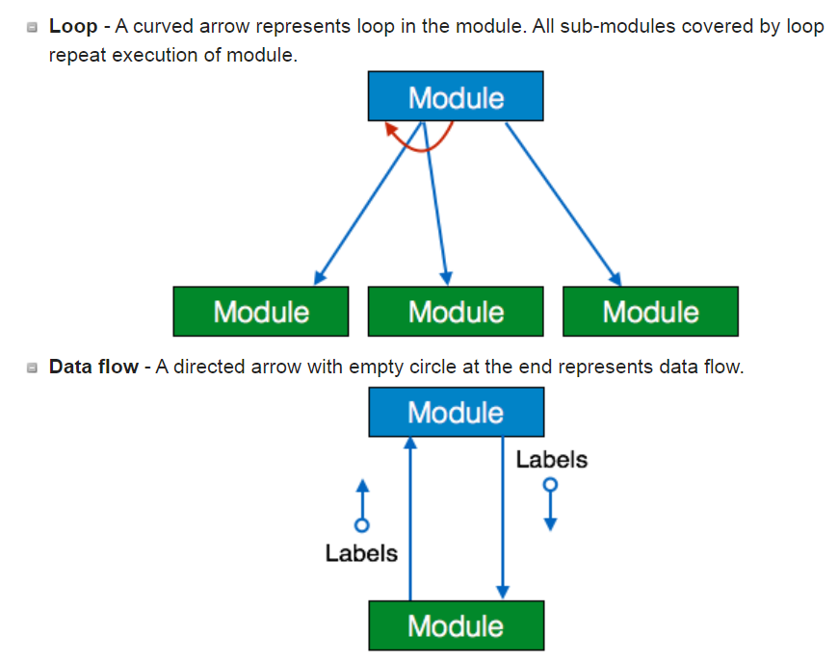

Slide 6
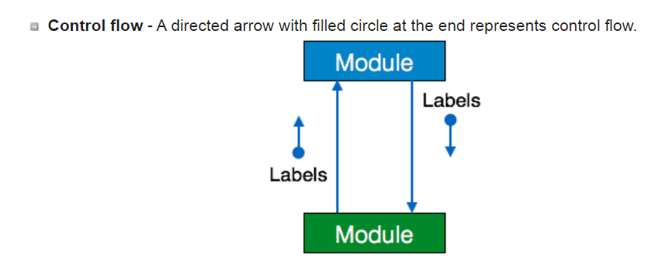

Slide 7
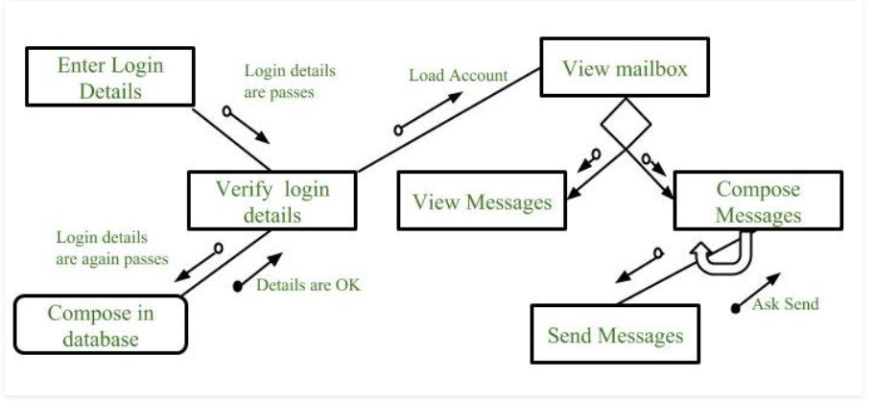
Structure chart for an Email server

Slide 8
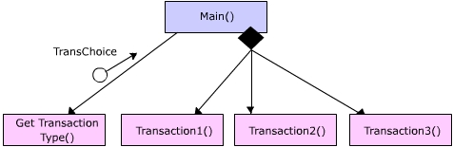
Example

